Slide 1

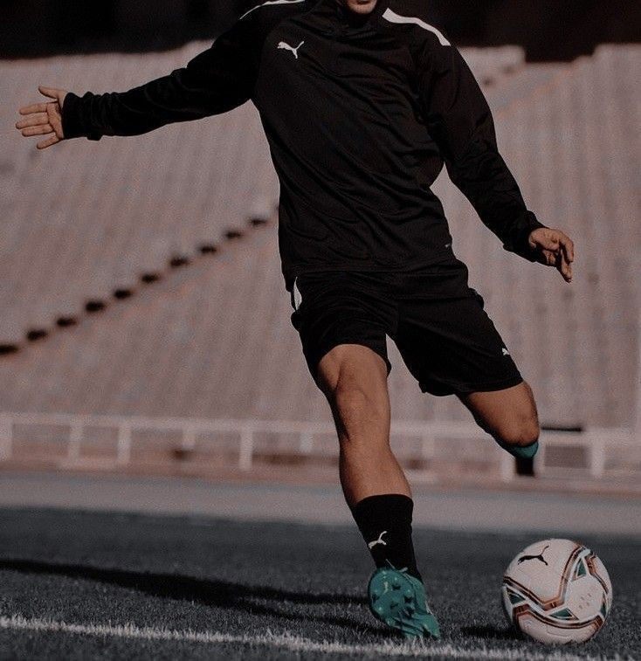


IRONHACK FC
THE BEST OF THREE

Slide 2
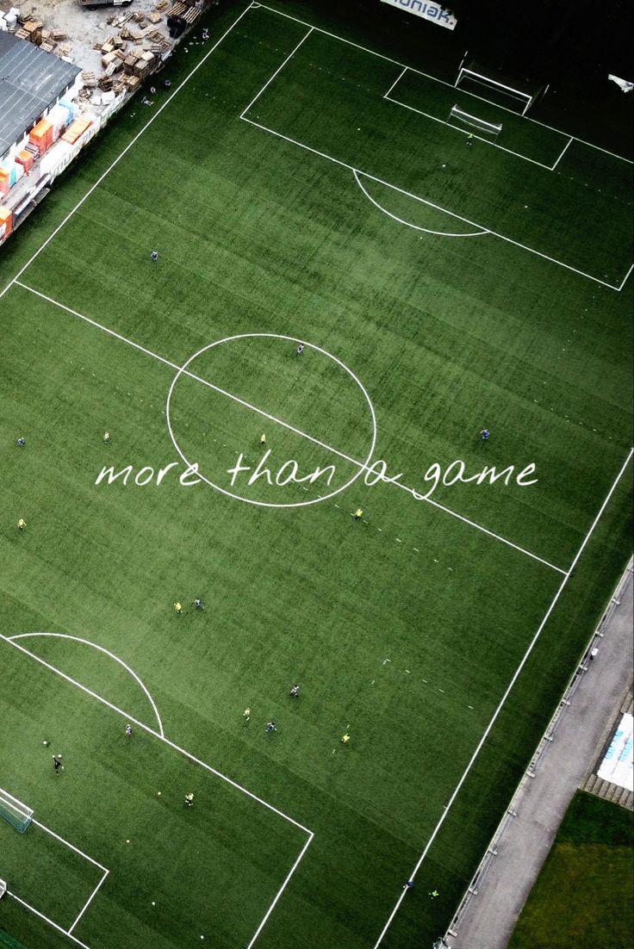
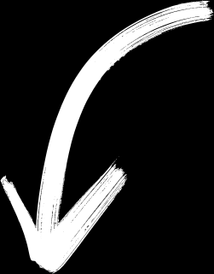


IRONHACK FC
LET’S PLAY THE GAME
Our challenge is, according to some attributes, to show you three of the best players. The future stars of our team.

Slide 3



SKILL
IRONHACK FC
Having a diverse set of skills is valued as it increases adaptability and effectiveness in different situations.
REACTIONS
Ability to quickly and effectively respond to changing situations on the field. This includes reacting swiftly to opportunities, challenges, or unexpected events during gameplay.
ATTRIBUTES
BASE STATS
Fundamental statistical metrics that provide an overview of a player's performance across different aspects of the game.
BALL CONTROL
Ability to receive, control, manipulate, and move the ball effectively using various parts of their body, such as feet, thighs, chest, and head.

Slide 4
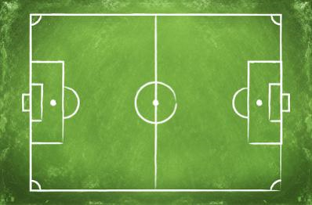
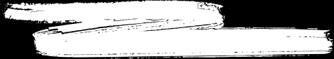

THE BEST OF THREE
IRONHACK FC
B. Ronhaar
N. Kanté
M.Neuer

Slide 5
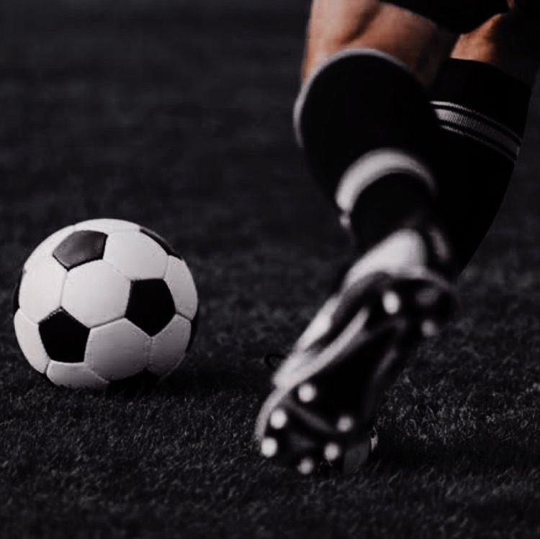
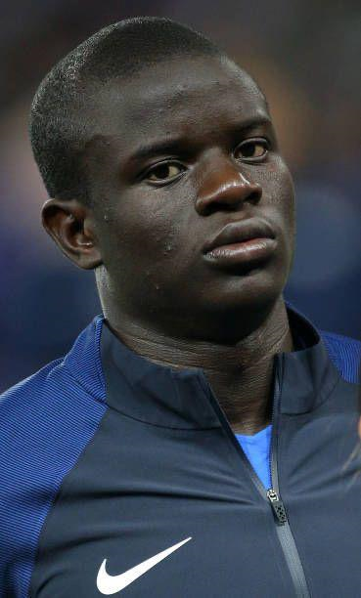
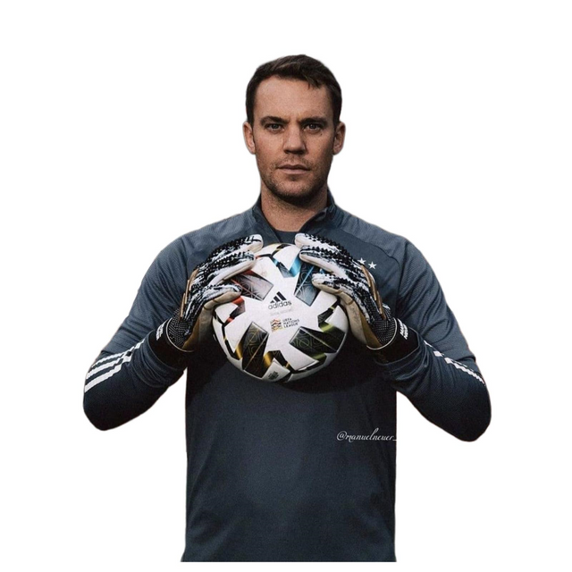

N'Golo Kanté is a French midfielder known for his exceptional ability to recover the ball, tireless stamina and tactical intelligence.
IRONHACK FC
Neuer is german and GK. He is known for his vital contribution to winning numerous titles at both national and international levels. His main skills are:
Remarkable reflexes
Foot ability
Area command
Leadership
B. Ronhaar is from Netherland and 23y.o. (Aug 11, 1984) 181cm / 5'11" 74kg / 163lbs. His best position is CF, by the way he has a weak foot,

